Slide 1




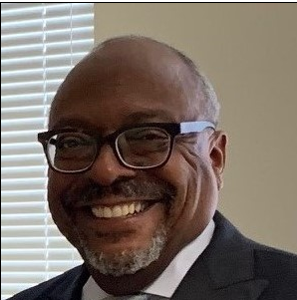
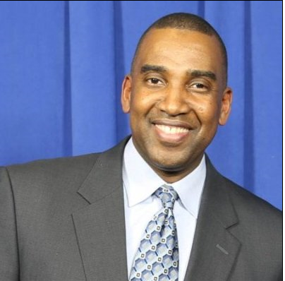
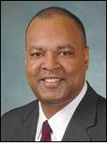
MBDA Baltimore Business Center presents:
Money in the Bag:
Top 7 Ways To Raise Capital
In Partnership with:
RSVP for this informative Webinar online.drexel.edu/mbda-webinar
Tuesday, October 22, 2019 at 2:00 PM as we discuss tips for accessing the capital you need to grow your business
Presentations By:
Gary Moore
Business Consultant
MBDA Baltimore Business Center
Kevin Coleman
Director of Strategic Partnerships
Drexel University Online
Anthony Caudle
CEO
RedTail Capital Markets

