Slide 1



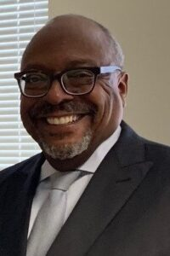
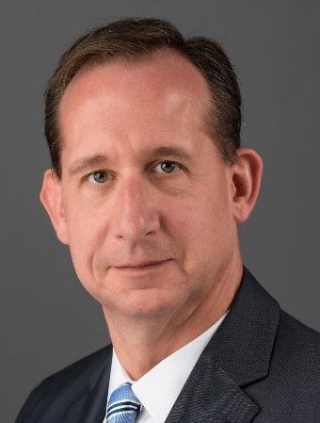
BALTIMORE BUSINESS CENTER
ProcurementCONNECT Series
Wednesday, September 23, 2020 at 8:30 AM
Seeking Construction Contractors for Maintenance, Repairs and Alteration on Various Commercial Buildings:
Building Exterior, Cabinetry, Ceiling, Curb Painting, Drywall, Electrical, Exterior Façade, Flooring, General Construction, Millwork, Painting, Parking Garage Repair and Paving Lot String
RSVP for this INVITATION ONLY ProcurementCONNECT at the link below:
https://zoom.us/meeting/register/tJ0lf-GorjMqGtXBxPwOT_ZgRB2rXv1BRMvf
In Partnership with:
Howard Hughes Management Services Company
Don’t miss this opportunity!
PROCUREMENT LISTED
RSVP TODAY
Baltimore MBDA Business Center
Phone Number: 667-303-3530
Gary Moore
Brent Wise
Business Development Specialist
Vice President/Portfolio Manager
Baltimore MBDA Business Center
Howard Hughes Management Services Company
Owned and Operated by: L. S. Caldwell & Associates, Inc.

